Slide 1
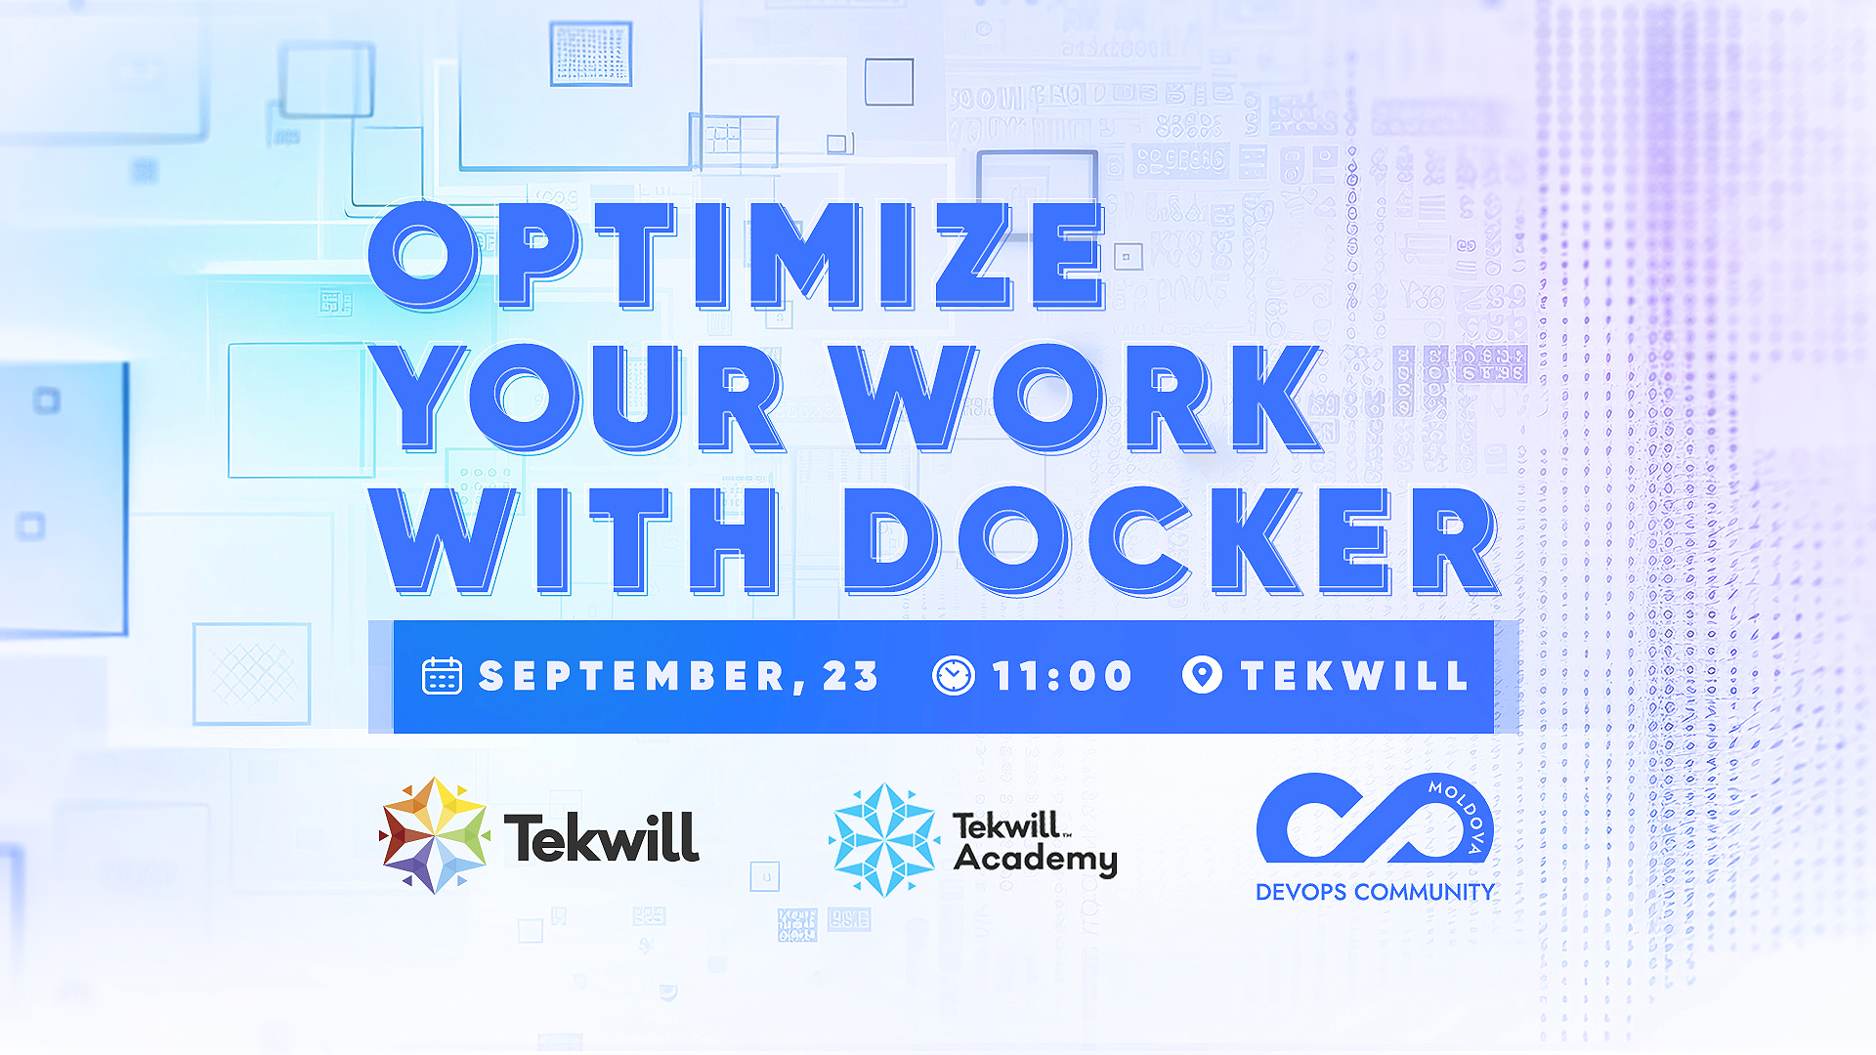

Slide 2
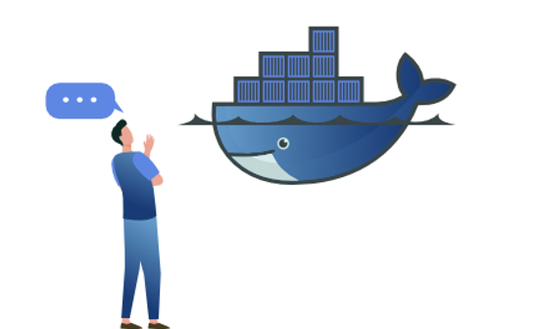
Fundamental Elements of the Docker Universe
Veronica Hajdeu
DevOps Engineer at Endava

Slide 3
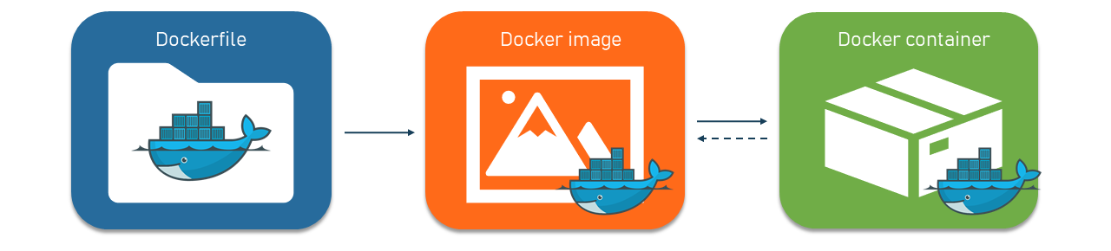
Docker elements: Dockerfile, Image, Container

Slide 4



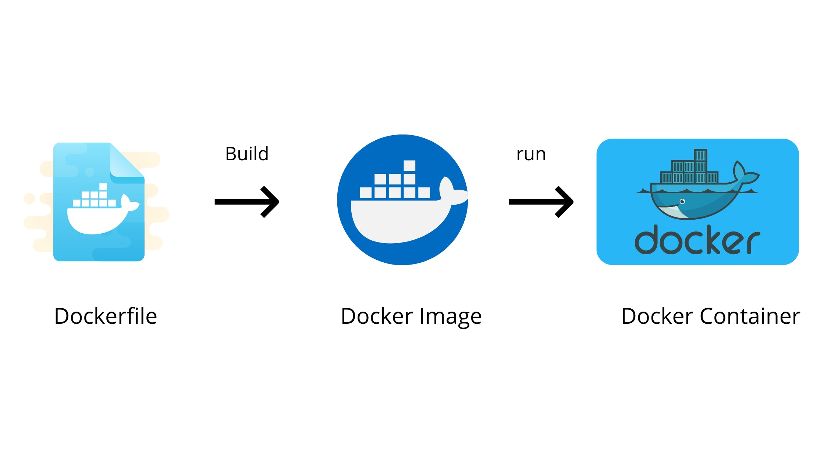

Slide 5
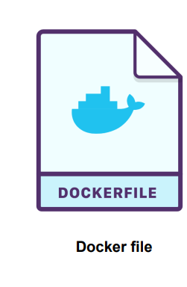
What is Docker File
# Use an official Python runtime as the base image
FROM python:3.8
# Set the working directory inside the container
WORKDIR /app
# Copy the current directory's contents into the container at /app
COPY . /app
# Install any needed packages specified in requirements.txt
RUN pip install --trusted-host pypi.python.org -r requirements.txt
# Make port 80 available to the world outside this container
EXPOSE 80
# Define environment variable
ENV NAME World
# Run app.py when the container launches
CMD ["python", "app.py"]
A Dockerfile is simply a text-based file with no file extension that contains a script of instructions. Docker uses this script to build a container image.
Notes:
https://www.docker.com/blog/intro-guide-to-dockerfile-best-practices/

Slide 6
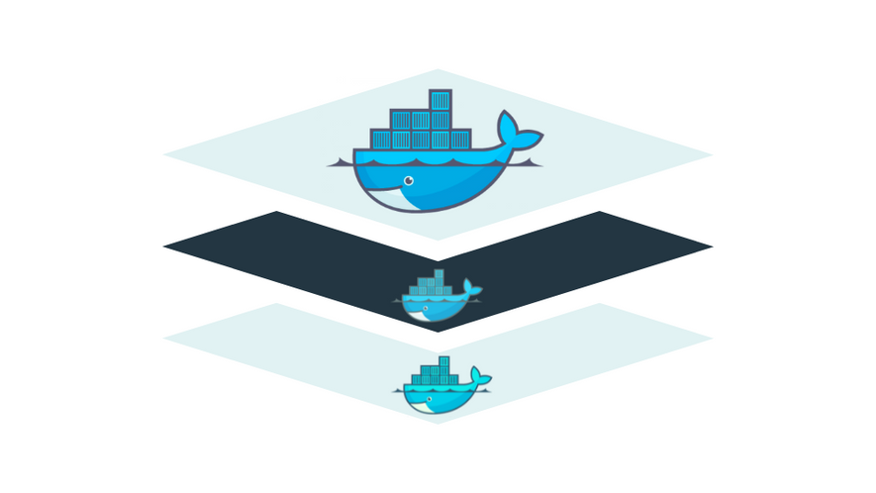
What is Docker Image
Images are read-only blueprints that include container-creation instructions.
An image is made up of numerous stacks, similar to the layers in a photo editor, each of which changes something in the surroundings. Images include the application’s code, or binary, runtimes, libraries, and other filesystem items.
Notes:
Images are read-only blueprints that include container-creation instructions. A Docker image is a container created to operate on the Docker framework. Consider an image a blueprint or picture of what will be in a container when it is operational.
An image is made up of numerous stacks, similar to the layers in a photo editor, each of which changes something in the surroundings. Images include the application’s code, or binary, runtimes, libraries, and other filesystem items.

Slide 7
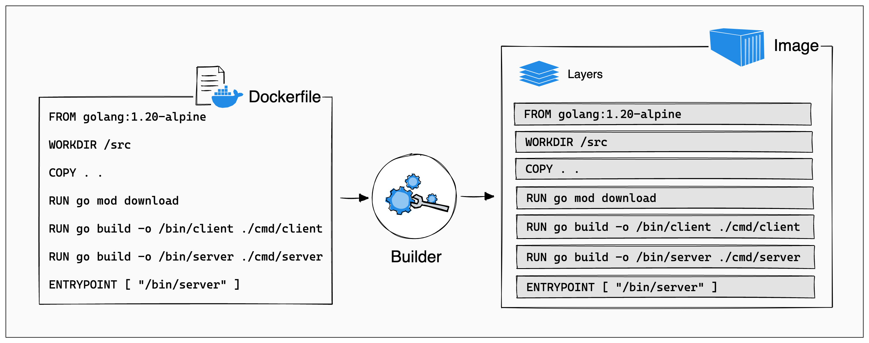
Docker Image Layers
A docker image is just a bunch of loosely-connected read-only layers

Slide 8
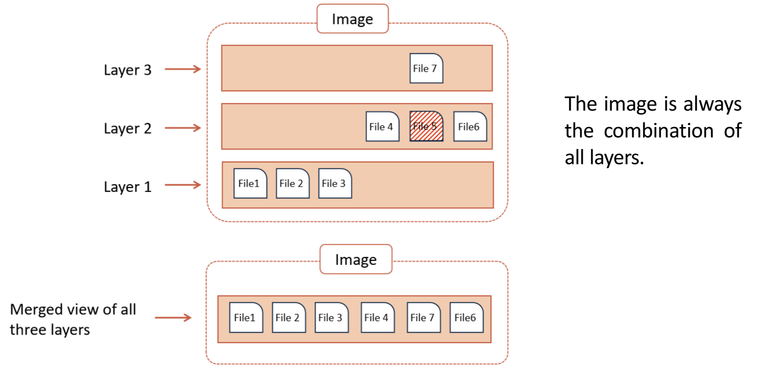
Docker Image Layers

Slide 9
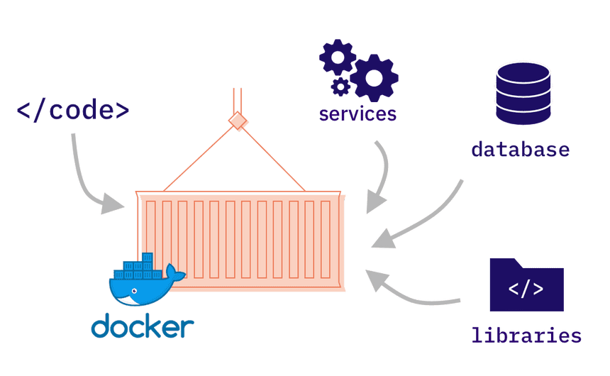
What is Docker Container
Containers are compact, virtualized runtime environments used to run applications. Each container is a software package including all of the configuration files, dependencies, system tools, libraries, and source code required to run a certain application.
They are distinct from the host and any other instances running on the host.
Notes:
The major difference between a container and an image is the top writable layer. All writes to the container that add new or modify existing data are stored in this writable layer. When the container is deleted, the writable layer is also deleted. The underlying image remains unchanged.​

Slide 10
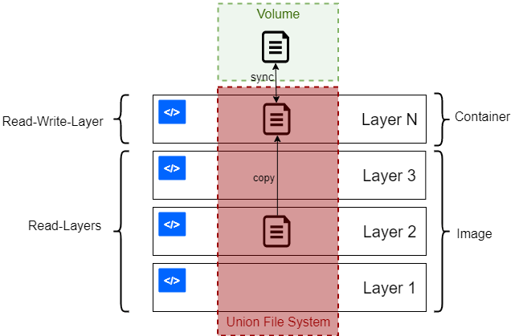
What is Docker Container
The major difference between a container and an image is the top writable layer. All writes to the container that add new or modify existing data are stored in this writable layer.
Notes:
The major difference between a container and an image is the top writable layer. All writes to the container that add new or modify existing data are stored in this writable layer. When the container is deleted, the writable layer is also deleted. The underlying image remains unchanged.​

Slide 11
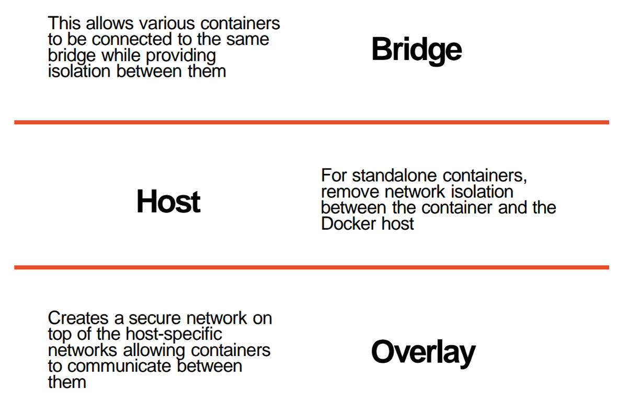
Docker Network

Slide 12
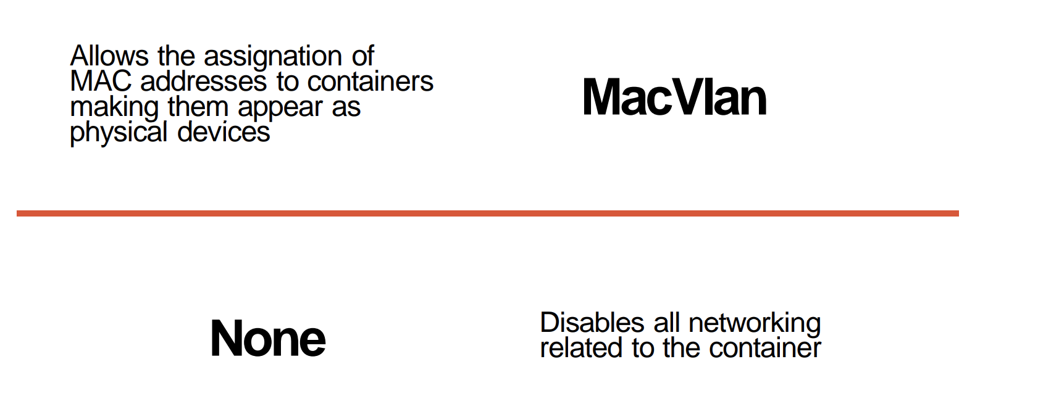
Docker Network

Slide 13
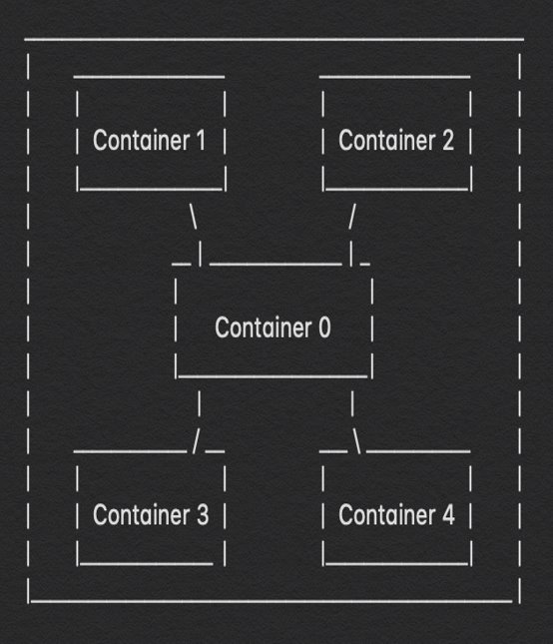
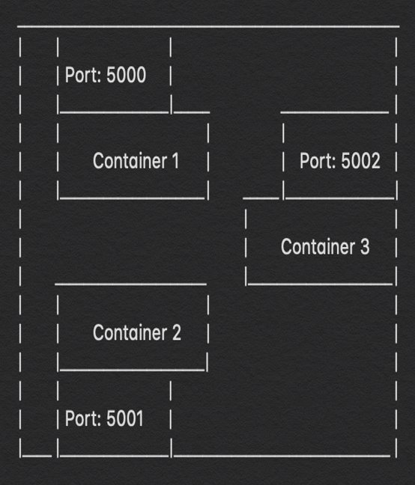
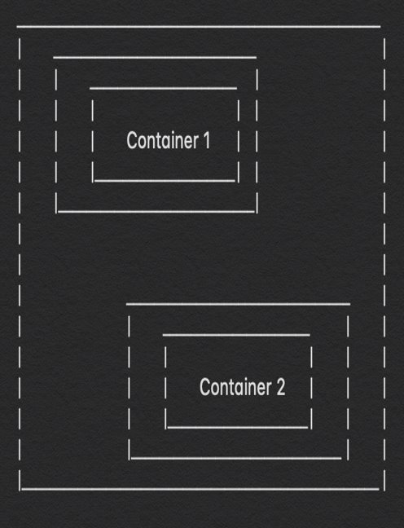
Docker Network
Bridge
Host
Isolated (Overlay)
$ docker network create --driver bridge --subnet 182.17.0.0/16 <network-name>
Notes:
Bridge Networks - Docker containers are running on a bridged network when all of them are on the same network of 172.17.0.0/16. In this way they can easily communicate between themselves. Host Networks - In this scenario the docker container’s port are mapped to the port of the host machine. As we perform port mapping so no other container can use that port as it is already being used by other container. Isolated (Overlay) Networks -This is the case when there is a container running on a total different network form other docker containers and can’t communicate with any of them.

Slide 14
Docker Volumes
Is the mechanism used to persist data generated and used by Docker, this file structure are completely managed by Docker.
Notes:
Volumes are stored in a part of the host filesystem which is managed by Docker (/var/lib/docker/volumes/ on Linux). Non-Docker processes should not modify this part of the filesystem. Volumes are the best way to persist data in Docker.​
​
Bind mounts may be stored anywhere on the host system. They may even be important system files or directories. Non-Docker processes on the Docker host or a Docker container can modify them at any time.​
​
Tmpfs mounts are stored in the host system’s memory only, and are never written to the host system’s filesystem.

Slide 15
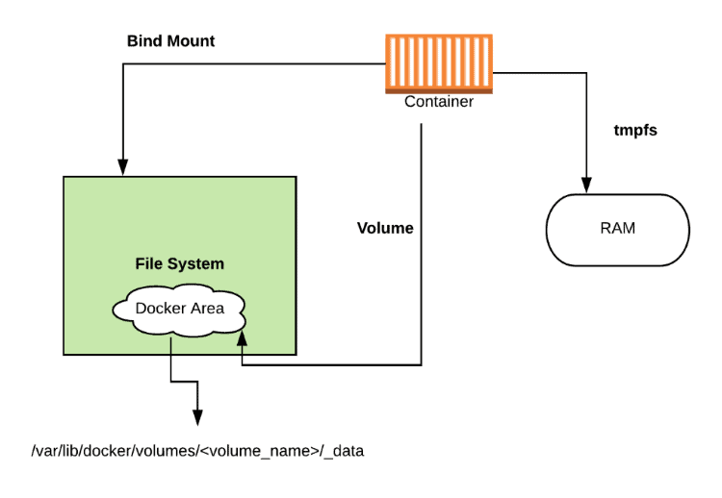
Docker Volumes
Docker storage distinguishes three storage types. Two types are permanent: Docker volumes and bind Mounts and the third way of writing data is tmpfs that is not permanent. The data is written directly on to the host’s memory and deleted when the container is stopped.
Notes:
Docker storage distinguishes three storage types. Two types are permanent: Docker volumes and bind Mounts and the third way of writing data is tmpfs that is not permanent. The data is written directly on to the host’s memory and deleted when the container is stopped.
The difference between these is, volumes have a dedicated filesystem on the host (/var/lib/ docker/volumes) and are directly controlled through the Docker CLI. On the other hand, bind mounts use any available host filesystem. Whereas tmfs, uses the host memory.
From the container perspective, it doesn’t know what sort of storage is in use.
Volumes are stored in a part of the host filesystem which is managed by Docker (/var/lib/docker/volumes/ on Linux). Non-Docker processes should not modify this part of the filesystem. Volumes are the best way to persist data in Docker.​
​
Bind mounts may be stored anywhere on the host system. They may even be important system files or directories. Non-Docker processes on the Docker host or a Docker container can modify them at any time.​
​
Tmpfs mounts are stored in the host system’s memory only, and are never written to the host system’s filesystem.

Slide 16
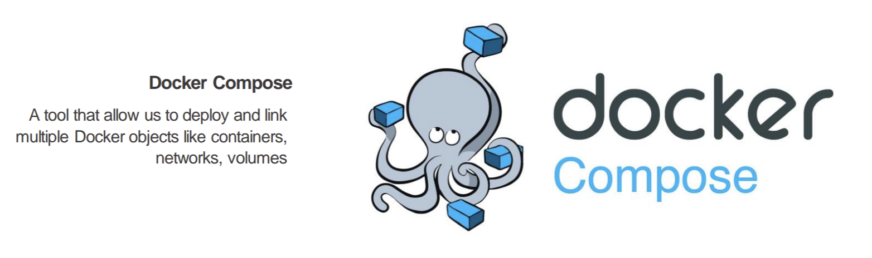
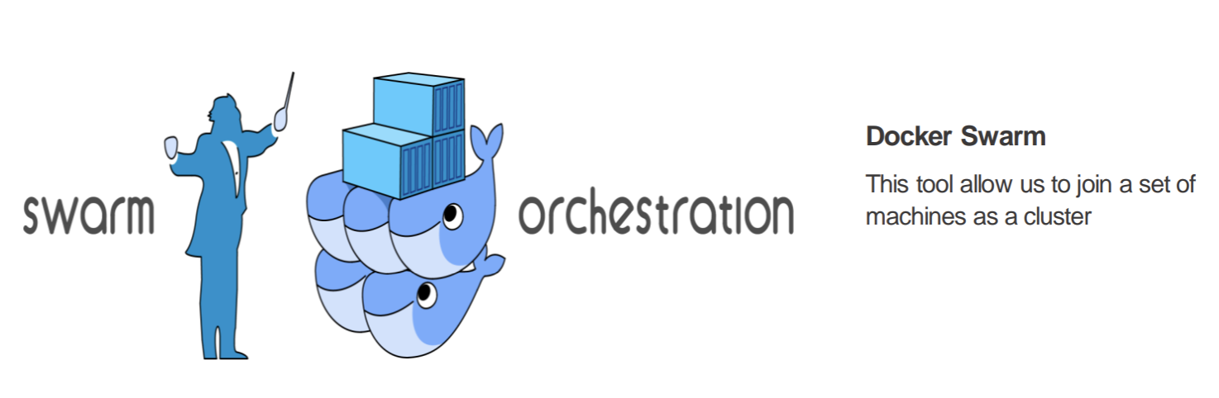
Advanced elements in Docker universe:
Docker Compose & Docker Swarm

Slide 17
What is Docker Compose?

Slide 18
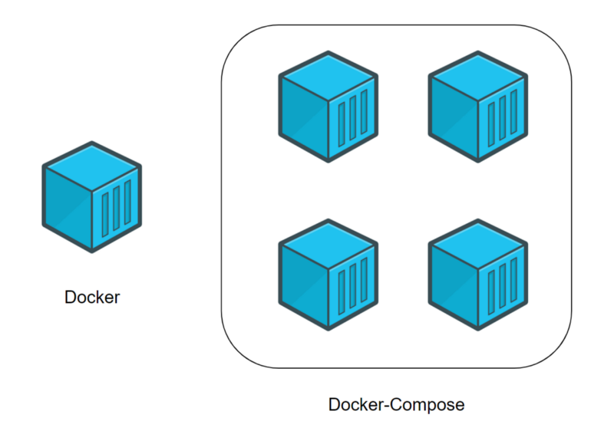
Docker Compose
​
Is a tool for defining and running multi-container Docker applications in a single env/network (e.g. Web and DB app)​ ​ With Compose, we use a YAML file to configure our application’s services. ​
Then, with a single command, we can create and start all the services from our configuration. ​
Notes:
Compose is a tool for defining and running multi-container Docker applications.​ Multi-container is single env/network with multiple containers in it (e.g. Web and DB app)​ ​ With Compose, we use a YAML file to configure our application’s services. ​ Then, with a single command, we can create and start all the services from our configuration. ​

Slide 19

Docker Compose Features
MULTIPLE ISOLATED ENVIRONMENTS ON A SINGLE HOST​
PRESERVE VOLUME DATA WHEN CONTAINERS ARE CREATED​
ONLY RECREATE CONTAINERS THAT HAVE CHANGED​
VARIABLES AND MOVING A COMPOSITION BETWEEN ENVIRONMENTS​
Notes:
MULTIPLE ISOLATED ENVIRONMENTS ON A SINGLE HOST​
Running multiple DEV, STAGE, PRODUCTION env side by side with different project names. ​
CI testing with project commit ID as a name of a single build for easier referencing​
Project name is the name of docker-compose.yml directory or we can use “-p” for custom name.
PRESERVE VOLUME DATA WHEN CONTAINERS ARE CREATED​
Compose save volumes from previous runs and attach them to new ones which ensure that you don’t lose your previous data e.g. database files, configuration files etc.
ONLY RECREATE CONTAINERS THAT HAVE CHANGED​
Compose save cache configuration of previous running container for quick changes.
VARIABLES AND MOVING A COMPOSITION BETWEEN ENVIRONMENTS​
Compose is able to use multiple compose files if needed. Typical case is different env and users. ​ In this way we would have docker-compose.yml, docker-compose.dev.yml, docker-compose.prod.yml​ and we would run it like this:​ docker-compose -f docker-compose.yml -f docker-compose.dev.yml –f docker-compose.prod.yml up -d

Slide 20
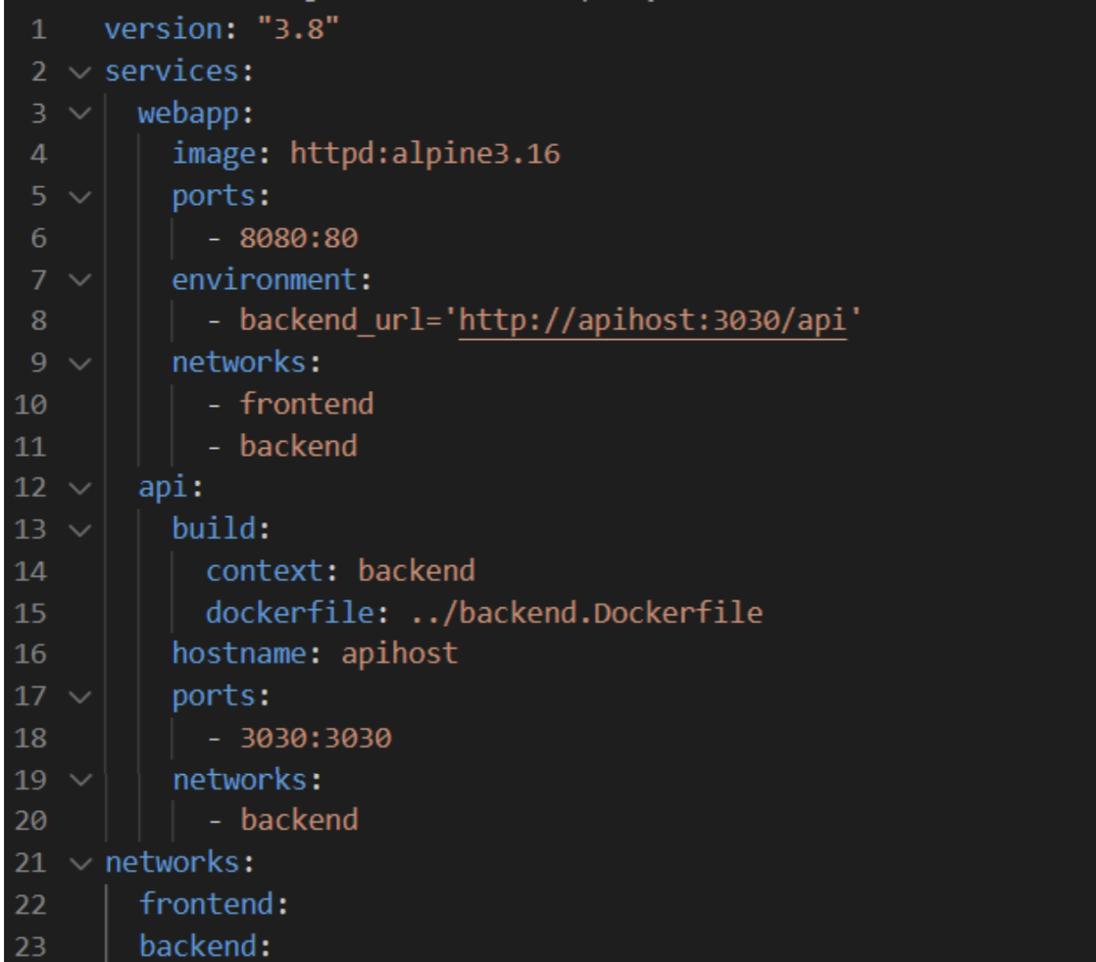
Docker Compose File Structure
Compose has commands for managing the whole lifecycle of your application:​
​
​
Start, stop, and rebuild services​
View the status of running services​
Stream the log output of running services​
Run a one-off command on a service

Slide 21
What is Docker Swarm?

Slide 22
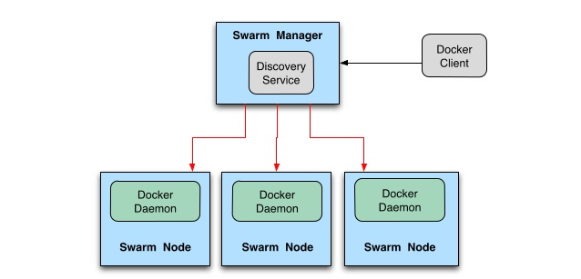
Docker Swarm Concepts
A node is a Docker engine instance that is part of the swarm.
Swarm cluster nodes can be spread over several machines on the cloud. There are two types of nodes, a manager node, and a worker node.
Notes:
A node is a Docker engine instance that is part of the swarm. This can also be thought of as a Docker server. One or more nodes may operate on a single physical device or cloud server. But in development, these swarm cluster nodes can be spread over several machines on the cloud. There are two types of nodes, a manager node, and a worker node.
Manager In the above image, we can see a swarm manager who is responsible to manage what a docker worker does. It maintains track of all of its workers' whereabouts. Docker Manager knows what job the worker is working on, what task it has been allocated, how assignments are distributed to all jobs, and whether the worker is up and running. Docker Manager's API is used to build a new service and orchestrate it. Assigns tasks to workers using the worker’s IP addresses.
Worker The Docker Manager has complete power over a Docker Worker. The Docker Worker accepts and executes the tasks/instructions that the Docker Manager has delegated to it. A Docker Worker is a client agent that informs the manager about the state of the node it’s been running on through a REST API over HTTP protocol.

Slide 23
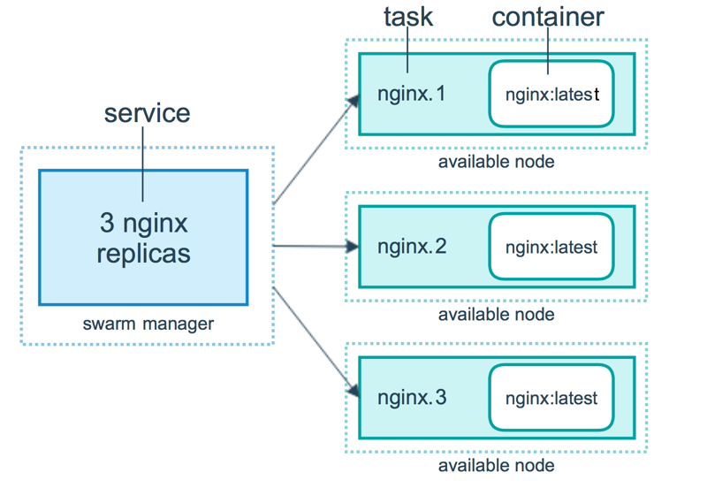
Docker Swarm
The tasks to be executed on the manager or worker nodes are described by a service. It is the swarm system's core mechanism and the main point of user engagement with the swarm.
When you create a service, you also create containers and also specify tasks, which must be executed inside them.
Notes:
The tasks to be executed on the manager or worker nodes are described by a service. It is the swarm system's core mechanism and the main point of user engagement with the swarm. When you create a service, you also create containers and also specify tasks, which must be executed inside them. The swarm manager distributes a certain number of replica tasks among the nodes in the replicated resources model depending on the scale you set in the desired state.
A task in Docker Swarm is a running container that is part of a service. Docker Swarm schedules the tasks across the nodes in the cluster to balance the workload. Each task is assigned a unique identifier, and Docker Swarm monitors the state of the tasks to ensure they are running as expected

Slide 24
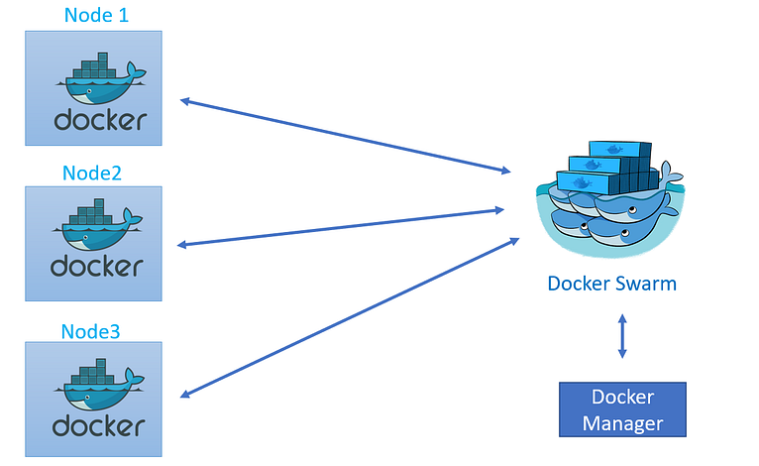
Docker Swarm
Benefits: ​
Straightforward to install.​
Less complex than other tools.​
Works/integrates easily with the Docker CLI and Docker compose.​
​
Challenges: ​
Lightweight and tied to the Docker API

Slide 25
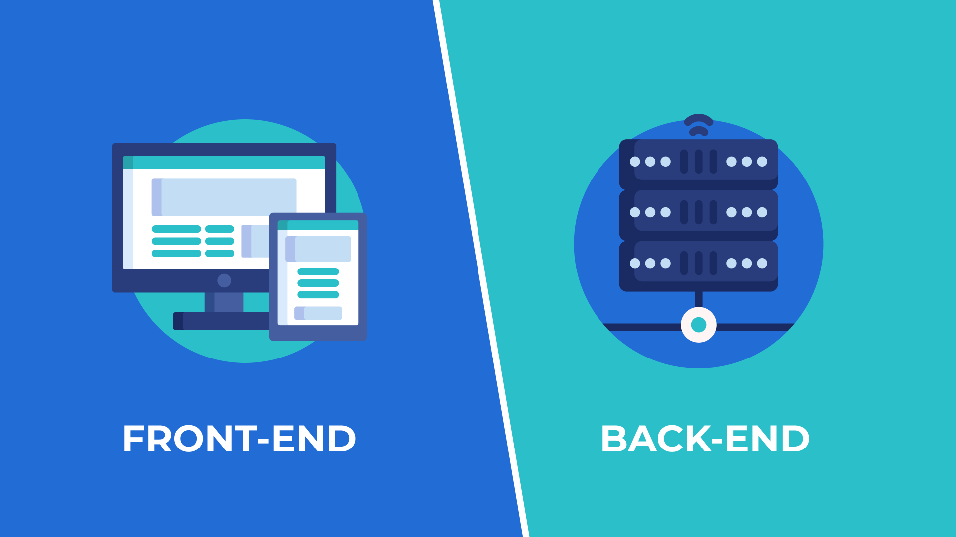
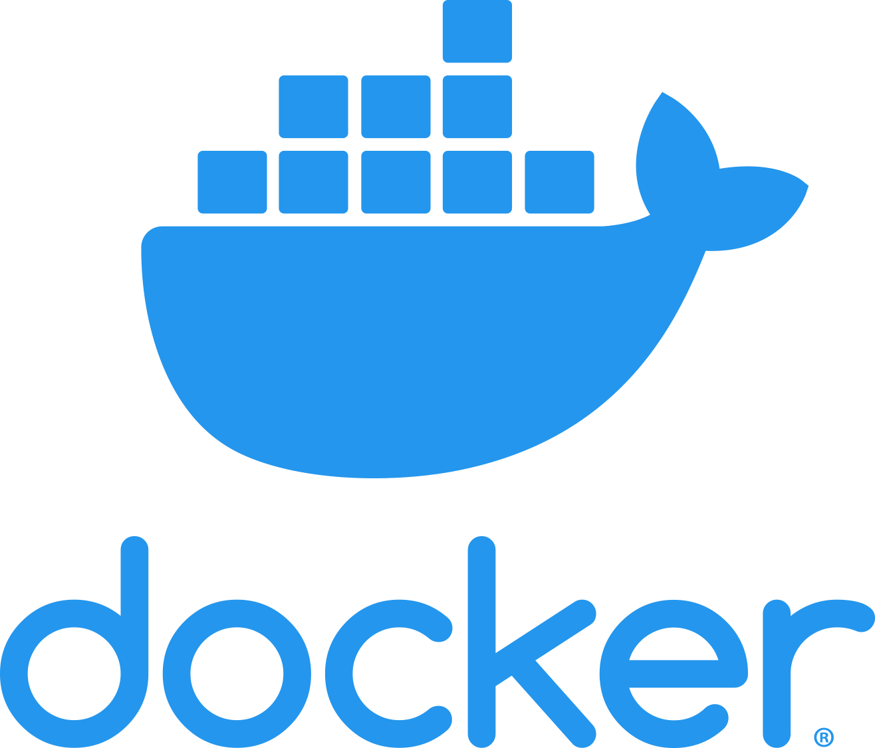
How to Dockerize Two Types of Applications: Backend and Frontend

Slide 26
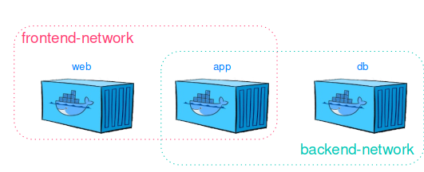
Dockerize Applications
Dockerize the application by creating a Dockerfile in its root directory.
Build the Docker image using the Dockerfile.
Push the Docker image to a container registry.
Create a Docker Compose file that defines the two services and their dependencies.
Run the Docker Compose file to start both services.

Slide 27
COMMAND​ | DESCRIPTION​
FROM​ | initializes a new build stage. Sets Base Image​
ADD *​ | copies new files, directories (or remote file URLs)* from <src> and adds them to the filesystem of the image at the path <dest>​
COPY​
ENV​ | sets the environment variable <key> to the value <value>​
EXPOSE​ | Exposes a network (TCP or UDP) port​
LABEL​ | adds metadata to an image (key-value)​
STOPSIGNAL​ | sets the system call signal that will be sent to the container to exit​

Slide 28
COMMAND​ | DESCRIPTION​
CMD​ | The main purpose of a CMD is to provide defaults for an executing container. ​ ​ CMD ["executable","param1","param2"] (exec form, this is the preferred form) ​ CMD ["param1","param2"] (as default parameters to ENTRYPOINT) ​ CMD command param1 param2 (shell form)​ ​ CMD ["nginx", "-g", "daemon off;"]​
RUN​ | The RUN instruction will execute any commands in a new layer on top of the current image and commit the results. The resulting committed image will be used for the next step in the Dockerfile.​
USER​ | sets the user name (or UID) and optionally the user group (or GID)​
VOLUME​ | creates a mount point with the specified name and marks it as holding externally mounted volumes from native host or other containers.​
WORKDIR​ | sets the working directory for any RUN, CMD, ENTRYPOINT, COPY and ADD​
Notes:
https://kapeli.com/cheat_sheets/Dockerfile.docset/Contents/Resources/Documents/index​
https://www.geeksforgeeks.org/what-is-dockerfile-syntax/

Slide 29
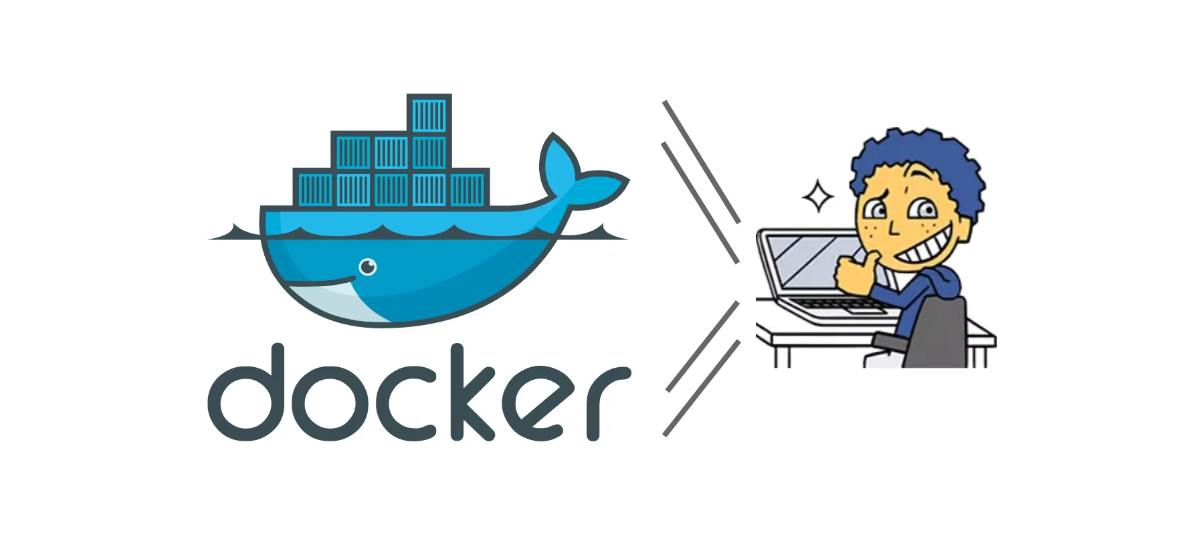
Best Practices

Slide 30
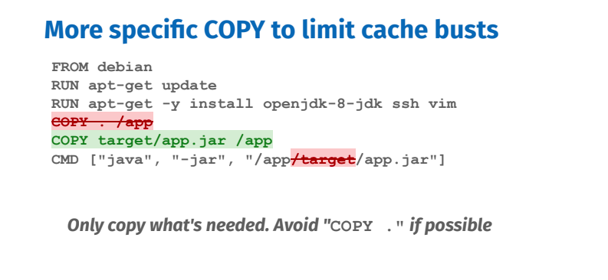

Slide 31
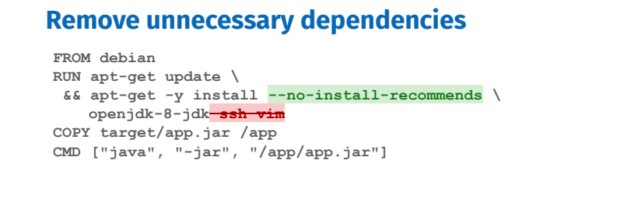

Slide 32
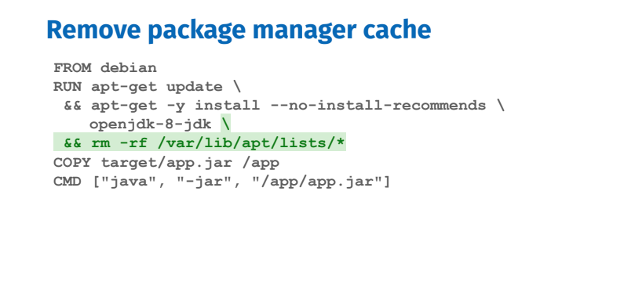

Slide 33
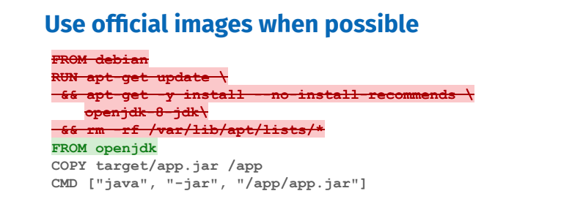

Slide 34
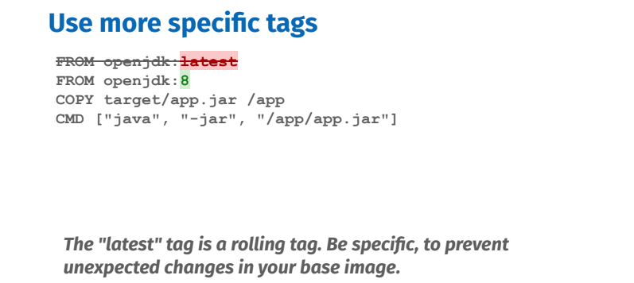

Slide 35
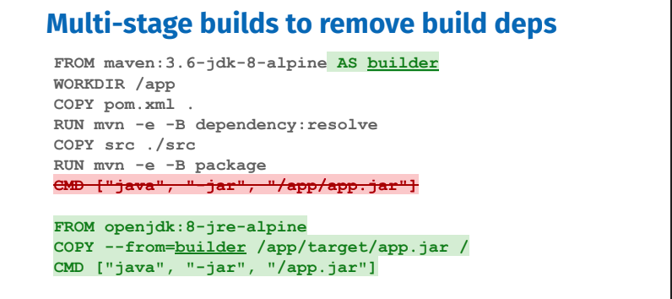

Slide 36
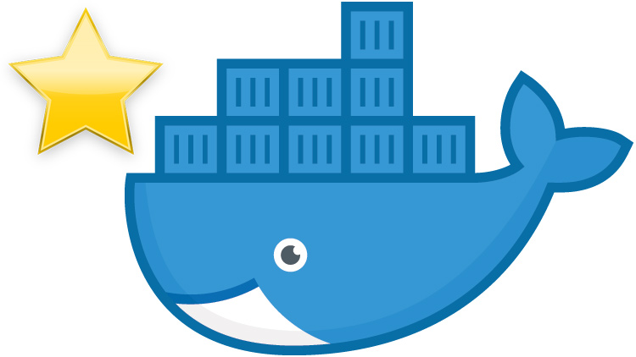
Thank you!

